Slide 1
ET TUTORIAL
AC CIRCUITS BASICS & NETWORK THEOREMS

Slide 2
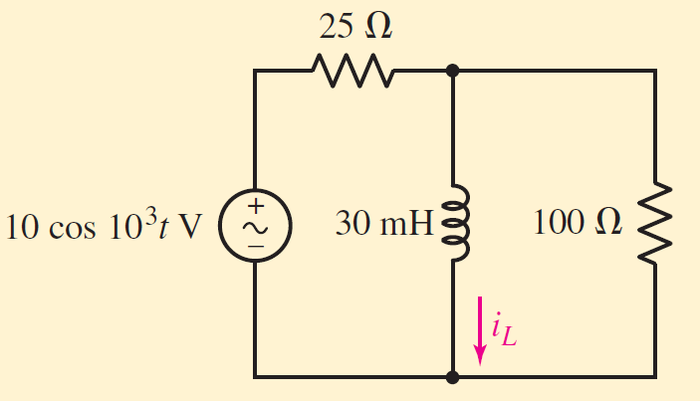
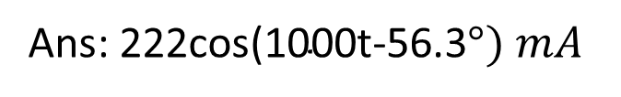
1. Find the current i_{L} in the circuit shown
Ans:$\text{222}\text{cos}\text{(1000}\text{t}\text{-56.3}°) mA$

Slide 3
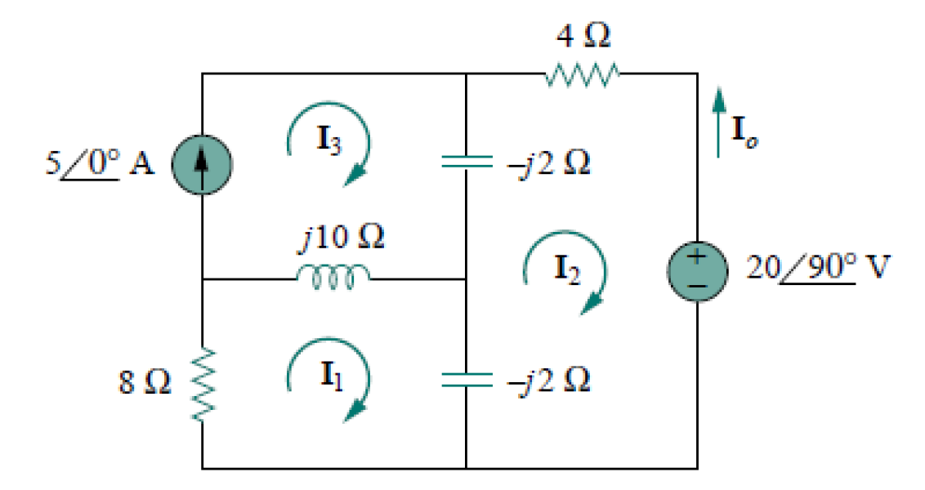

2. Determine I₀ using mesh analysis
Ans:$\text{6.12} ∠144.78°$

Slide 4
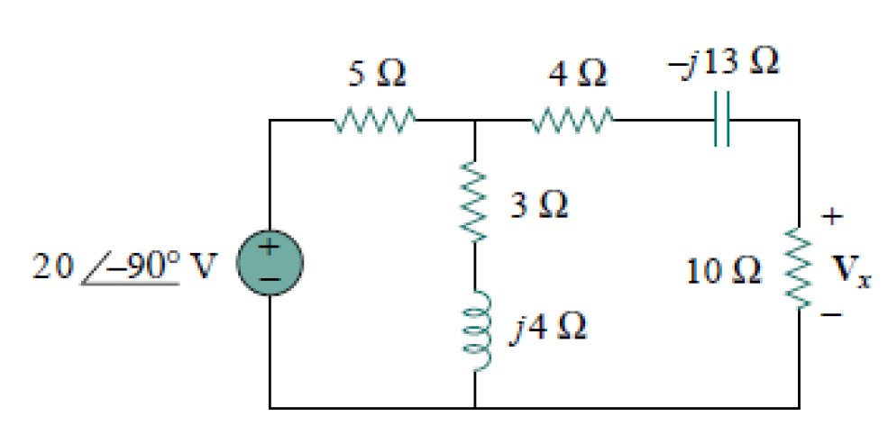

3. Calculate V_{x} in the circuit using source transformation
Ans:$\text{5.519 }∠−28°$

Slide 5
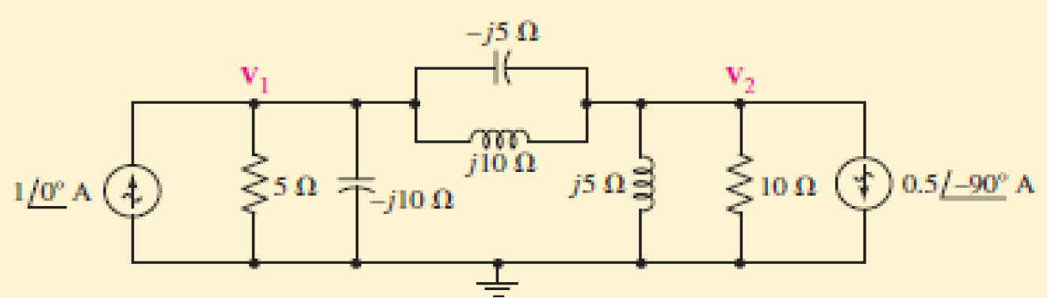
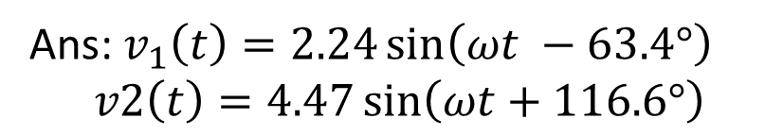
4. Find the time domain node voltages v1(t) and v2(t) in the circuit shown below using nodal analysis.
Ans:$v_{1}\left(t\right)=2.24\sin\left(ωt −63.4°\right)$
$$v2\left(t\right)=4.47\sin\left(ωt+116.6°\right)$$

Slide 6
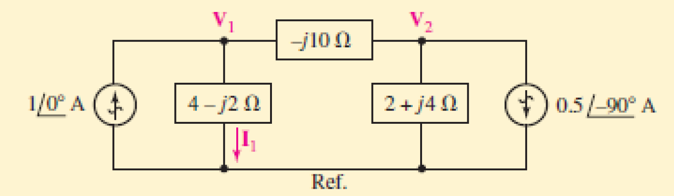

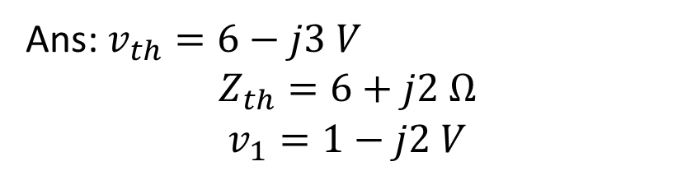
5. Determine the Thevenin equivalent as seen by the $–j10Ω$ impedance of the circuit shown below. Compute the voltage V₁.
Ans:$v_{th}=6−j3 V$
$$Z_{th}=6+j2 Ω$$
$$v_{1}=1−j2 V$$

Slide 7
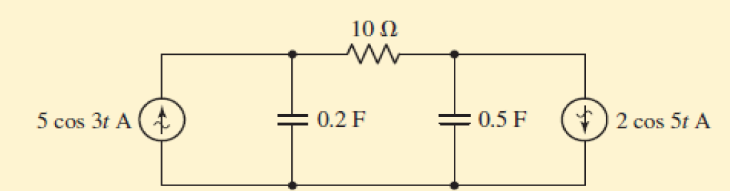
6. Determine the current in the 10Ω resistor in the circuit shown below:
Ans:

Slide 9
